Slide 1

The population genetics of StRESS-induced Mutation
A
G
ATA
Yoav ram
Hadany lab – the Evolutionary theory lab
Department of Molecular biology and ecology of plants
Life sciences faculty
Tel-aviv University
May 26 2014

Slide 2
Talk Overview
Mutation rate variability
Stress-induced mutagenesis
Evolution of stress-induced mutagenesis
Consequences of stress-induced mutagenesis

Slide 3
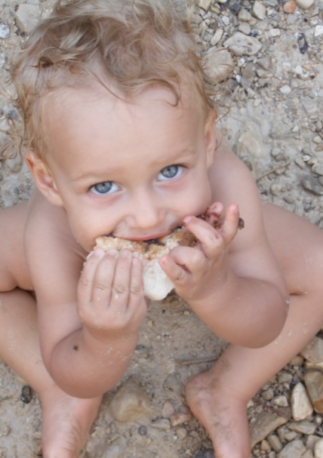
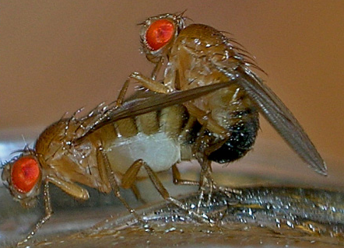
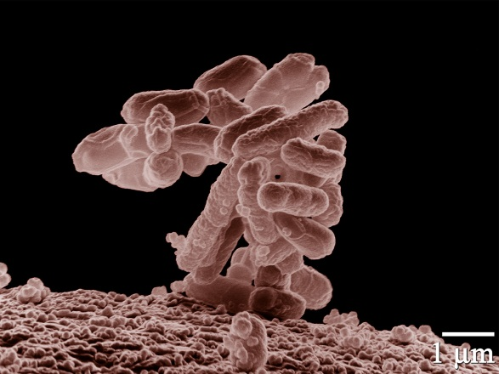
mutation rates Variability
Between species
Average # of measurable mutations per genome per generation
Flies: 0.455
Keightley et al. Gen Res 2009
Humans: 41
Lynch, PNAS 2010
Bacteria: 0.0004
Wielgoss et al. G3 2011

Slide 4
mutation rates Variability
Within species
Mutation rate in 69 natural populations of E. coli Matic et al. 1997

Slide 5
mutation rates Variability
Within individuals
DNA polymerase error rate Lynch 2011

Slide 6
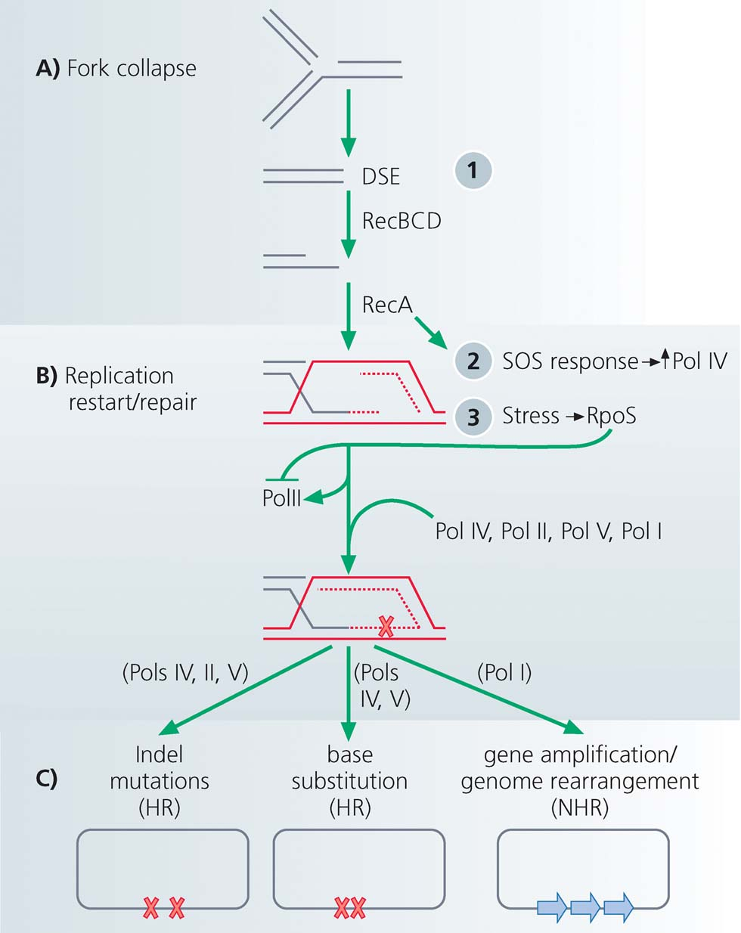
Stress-induced mutagenesis
Rosenberg et al. 2012
In E. coli:
Error prone polymerase induced by stress responses:
SOS response
DNA damage
Starvation
Mismatch repair system
Other mechanisms:
Galhardo et al. 2007
Al Mamun, Science 2012

Slide 7
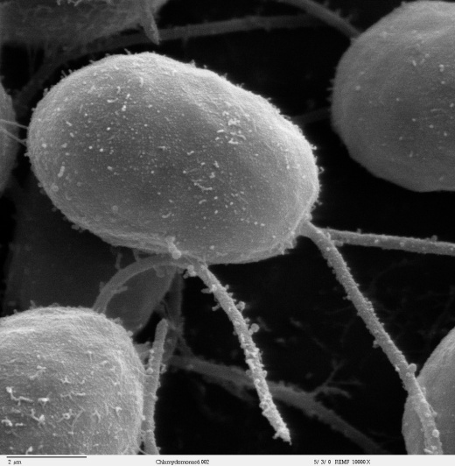
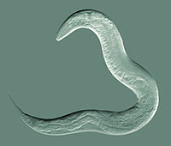
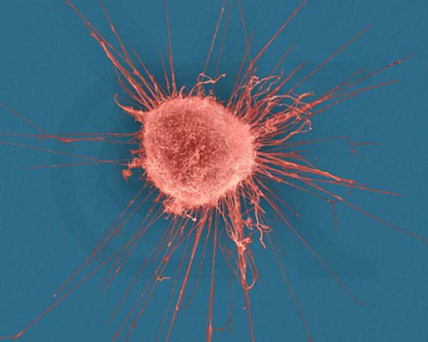

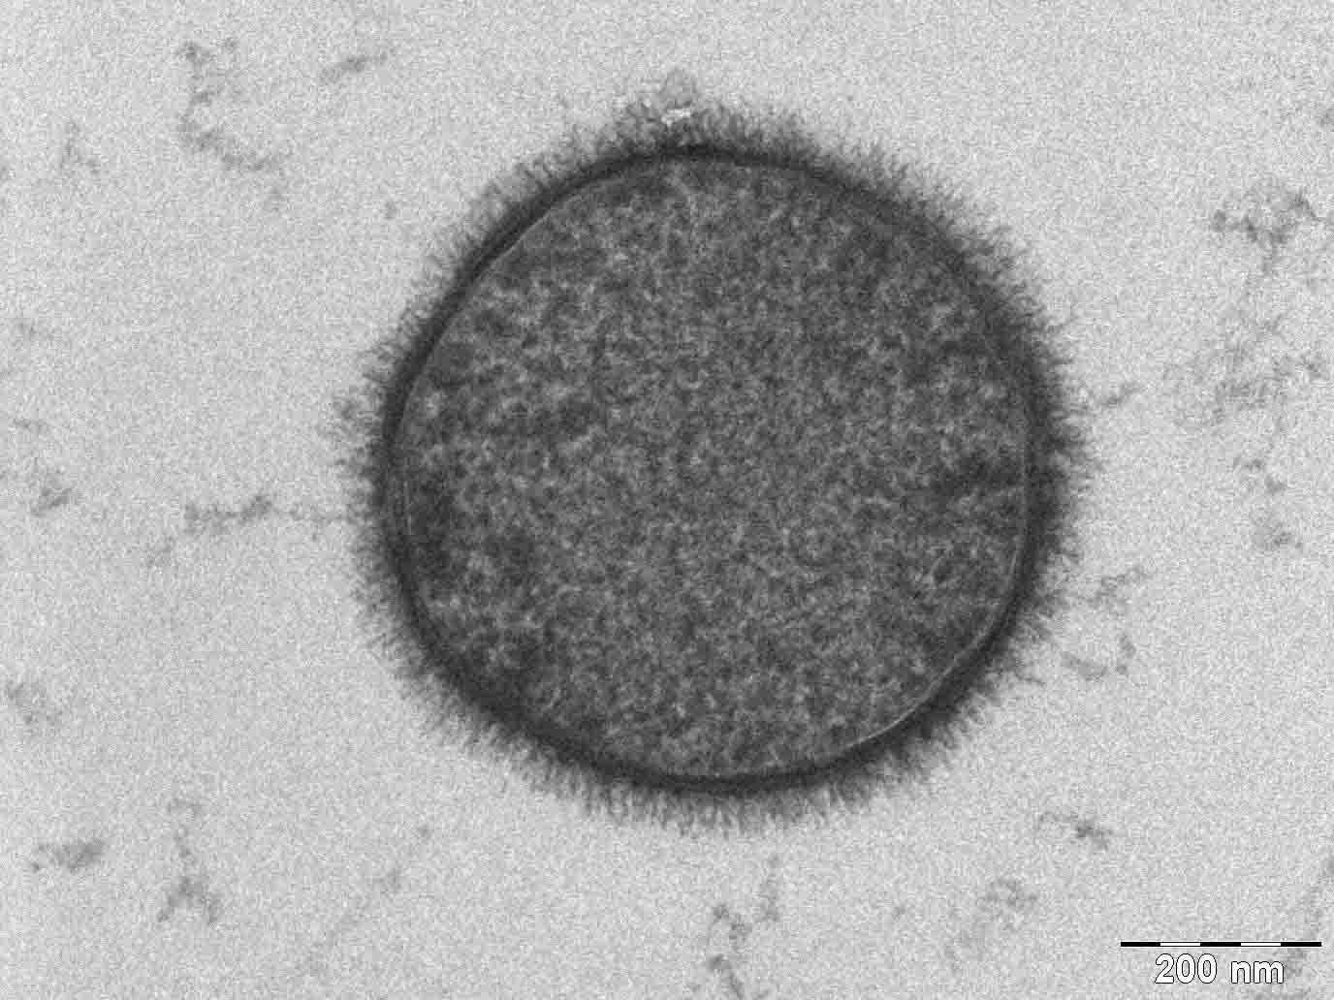
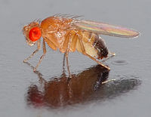
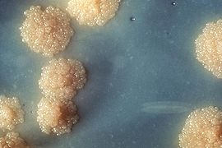
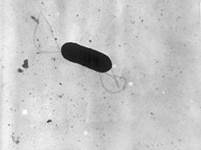
Evidence
Green algea
Nematodes
E. coli
Bacillus subtilis
Breast cancer cell
D. Melanogaster
M. tuberculosis
L. monocytogenes

Slide 8
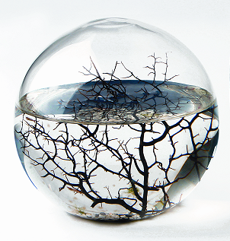
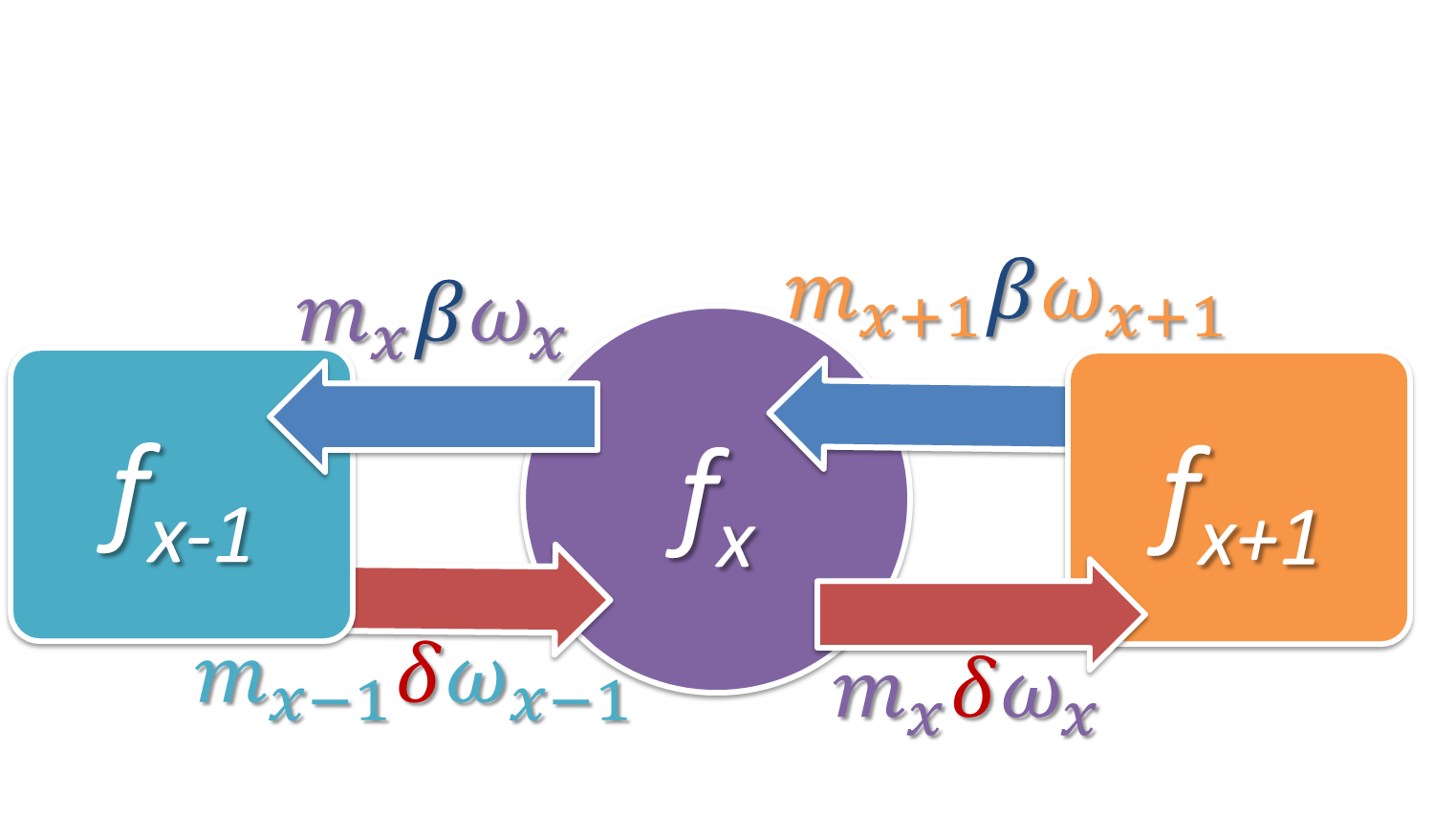
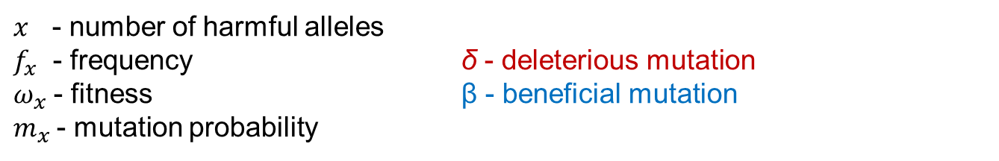
Constant environment
Selection against generation of deleterious mutations
$x$ - number of harmful alleles
$f_{x}$ - frequency δ - deleterious mutation
$ω_{x}$ - fitness β - beneficial mutation
$m_{x}$- mutation probability

Slide 9
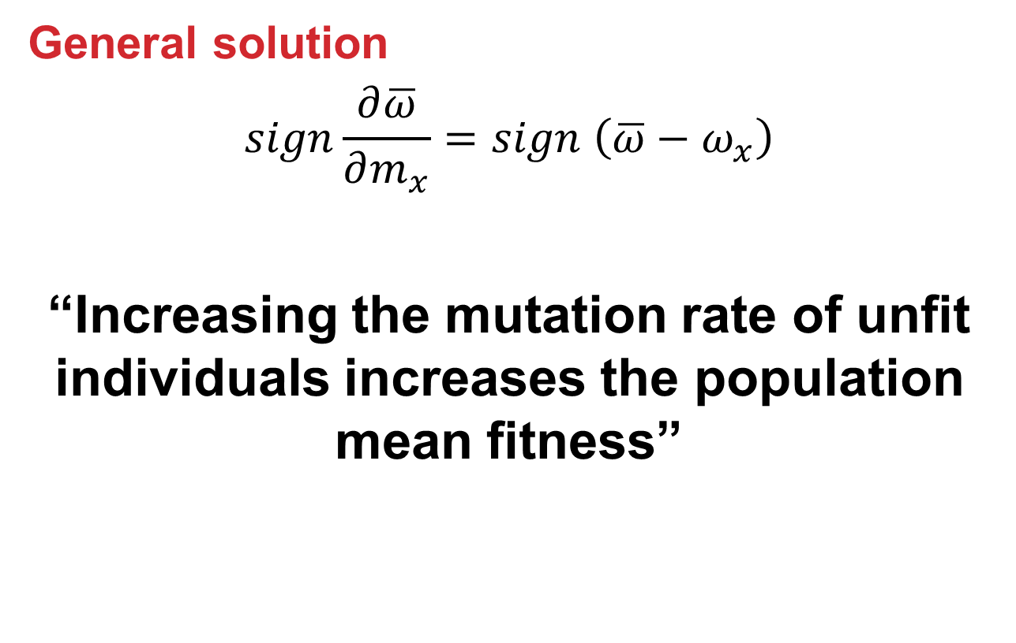
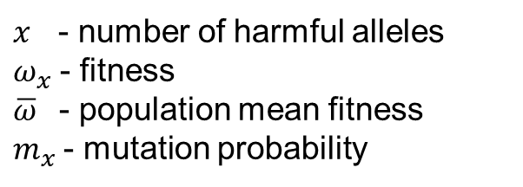
Constant environment: Mutation-Selection Balance
General solution
$$sign\frac{∂\overline{ω}}{∂m_{x}}=sign \left(\overline{ω}−ω_{x}\right)$$
“Increasing the mutation rate of unfit individuals increases the population mean fitness”
$x$ - number of harmful alleles
$ω_{x}$ - fitness
$\overline{ω}$ - population mean fitness
$m_{x}$- mutation probability

Slide 10

changing environments
The Red Queen hypothesis:
van Valen, 1973
“It takes all the running you can do, to keep in the same place.”
- Lewis Carrol, Through the Looking Glass
What happens if the environment changes frequently?

Slide 11
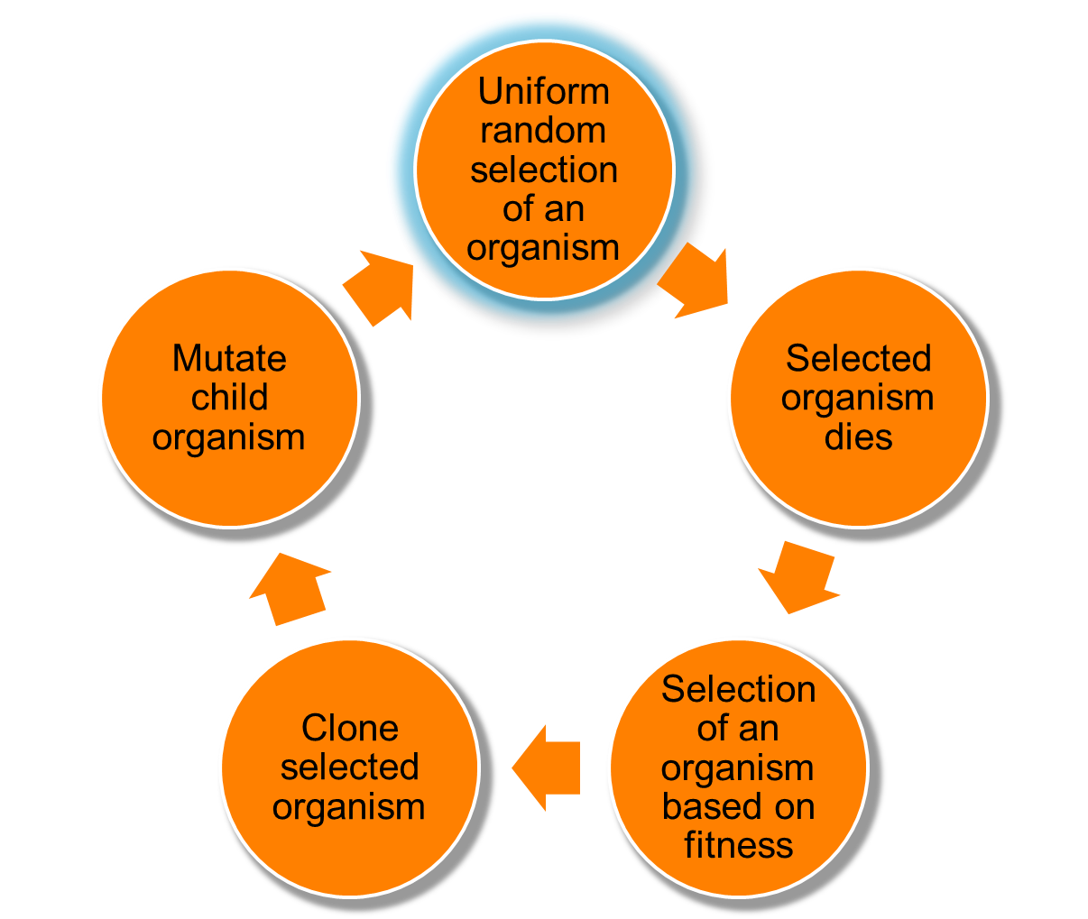
Changing environments
Simulation model
Individual-based simulations
100,000 individuals
1,000 loci
Asexual, Haploid
Overlapping generations
No recombination
No segregation
No mutations at mutator locus
Environmental changes

Slide 12
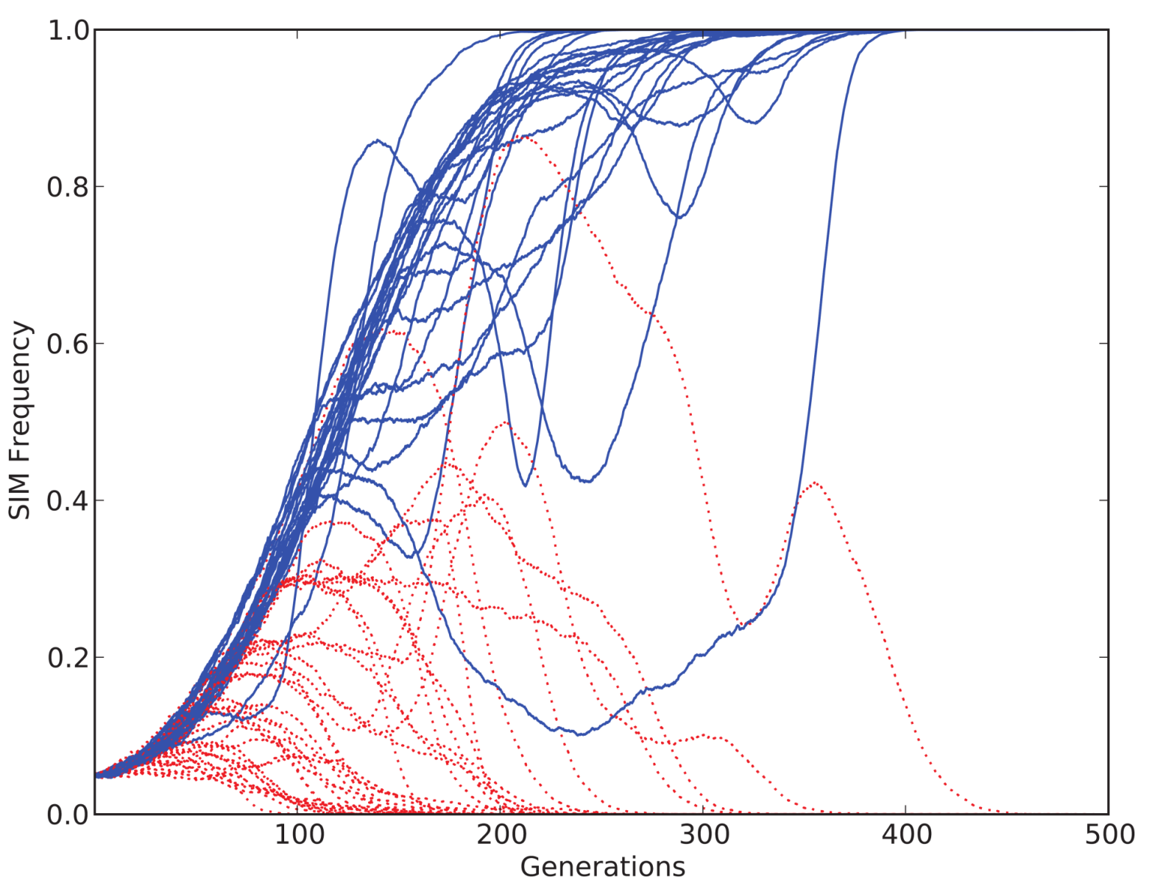
SIM vs. CM
CM: constitutive mutagenesis SIM: stress-induced mutagenesis
SIM Frequency
Simulation outcome:
SIM Wins
CM Wins
Generation

Slide 13
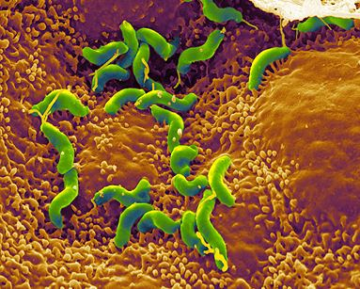
Summary: Evolution of stress-induced mutagenesis
Stress-induced mutators evolve:
In asexual populations
In constant & changing environments
Second order selection can lead to the evolution of stress-induced mutation in asexual populations
Selection for evolvability
H. pylori

Slide 14
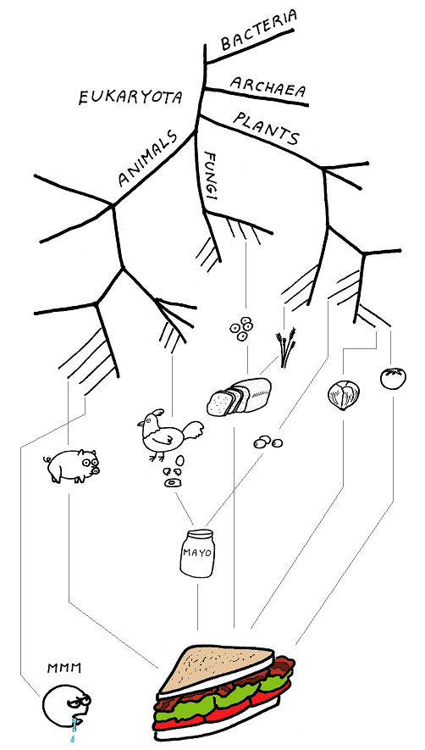
Consequences of stress-induced mutagenesis
What is the role of stress-induced mutagenesis in evolution?

Slide 15
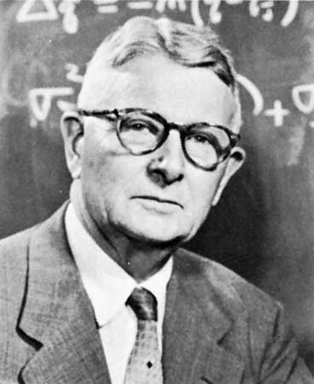
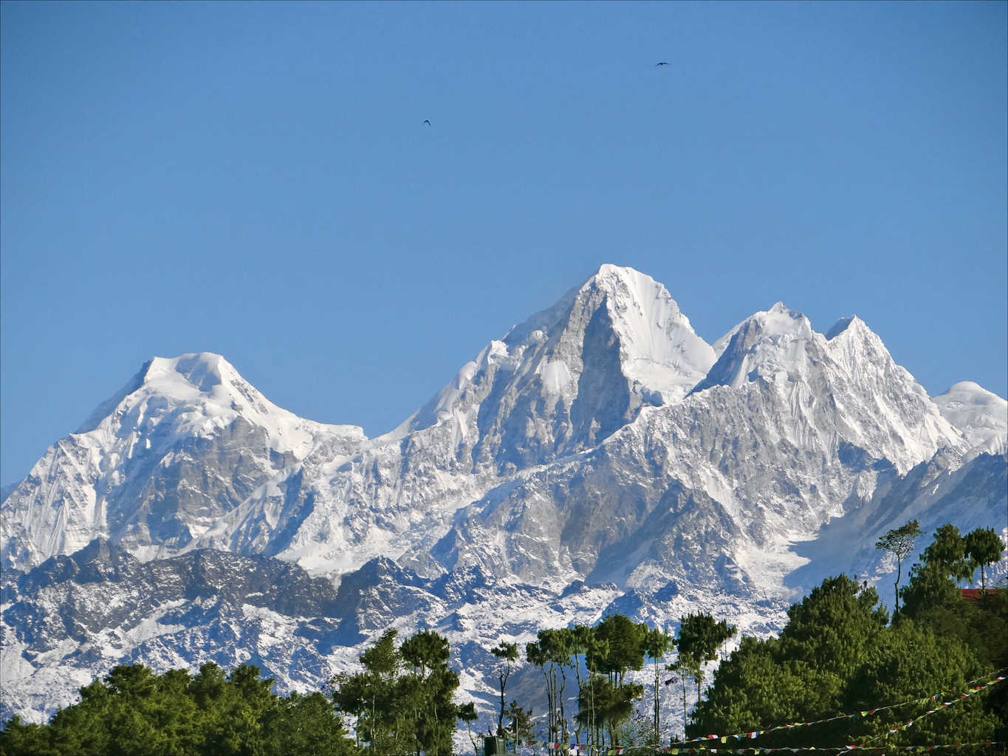
Adaptive Peak shifts
←Fitness→
High peak
Sewall Wright0
Low peak
Valley
←Genotype→

Slide 16
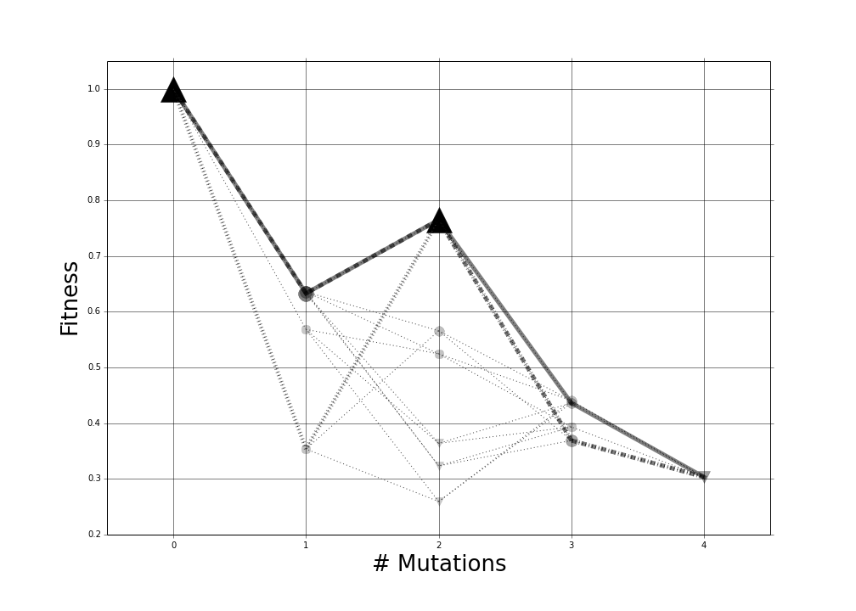
Empirical fitness landscape
TEM-1 β-lactamase
E104K+G238S
E104K+R164S
E104K+R164S+G238S
Relative
Cefotaxime
Resistance
R164S
E104K
E104K+R164S+R211P
R164S+R211P
Wild type
Schenk et al. 2013
Salverda et al. 2011

Slide 17
SIM & Adaptive Peak shifts
Increasing the mutation rate in individuals below both peaks
High mutation rate
Low mutation rate

Slide 18
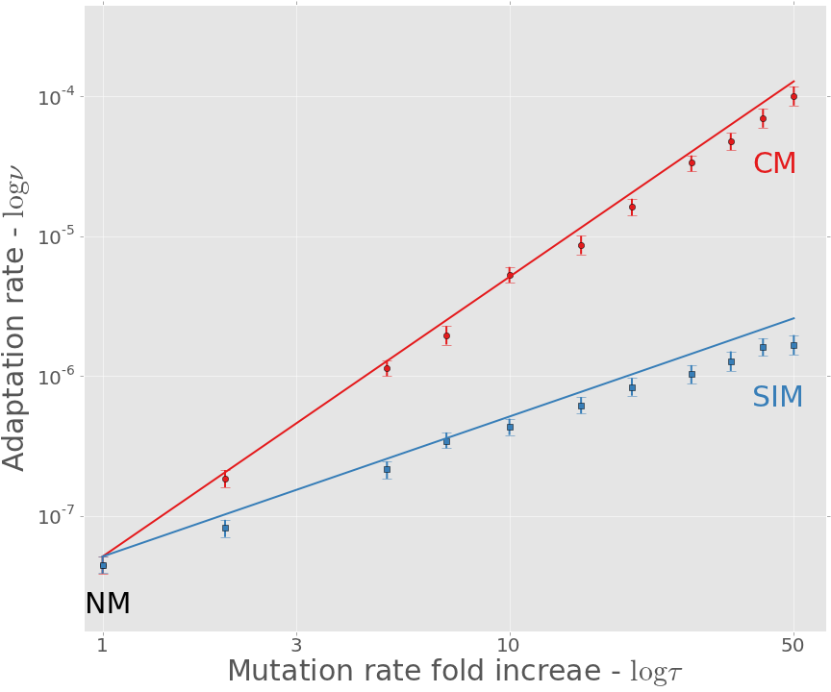
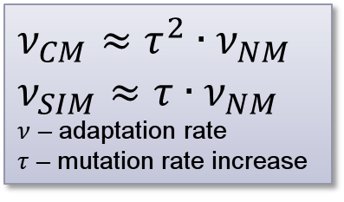
Adaptation rate
$$ν_{CM}≈τ^{2}∙ν_{NM}$$
$$ν_{SIM}≈τ∙ν_{NM}$$
$ν$ – adaptation rate
$τ$ – mutation rate increase
CM: constitutive mutagenesis SIM: stress-induced mutagenesis
Approximation
Simulation

Slide 19
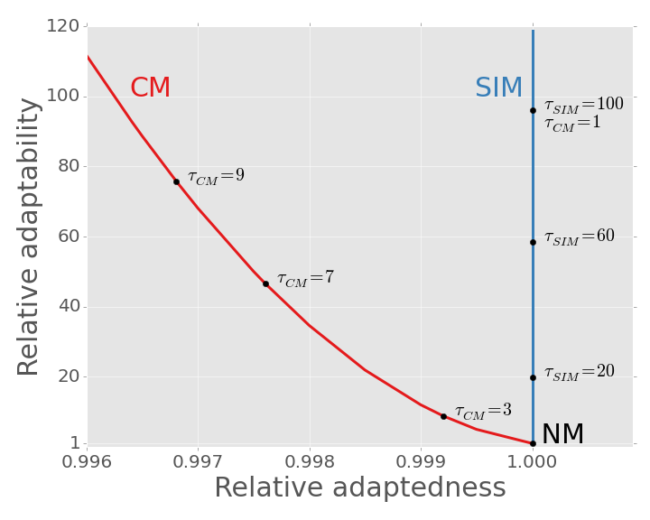
SIM Breaks the trade-off: adaptability & adaptedness

Slide 20
Conclusions
Evolution of stress-induced mutagenesis:
SIM can evolve due to 2nd order selection
In constant and changing environments
Consequences of stress-induced mutagenesis:
Breaks the trade-off between adaptability and adaptedness

Slide 21





Acknowledgments
Lilach Hadany
Uri Obolski
Ariel Guiejman
Eyal Zinger
Amalia Biron-Zigle Foundation
Contact
yoavram@post.tau.ac.il
@yoavram
http://www.yoavram.com

